Slide 1
Revolutionary Civic Activism and the Blending of TV and Social Media
By
Saed J. Abu-Hijleh
Director, Center for Global Consciousness (CGC)
Nablus, Palestine
Hanoi, Vietnam
May 2011

Slide 2
Social Media, TV, and Activism:
Seven Essential Questions?
How are contemporary modes of integration between TV and social media affecting revolutionary civic activism and vice versa?
How is Cyberspace being utilized to redefine the political organization of physical space?
What roles did the new blended media platforms play in the recent dramatic political changes in the Middle East?
Is the blending of social media and TV creating a new unified field for political activism?

Slide 3
Can we speak about mutuality in adaptation and influence between social movements and the technologies and platforms of social media and TV?
What are the differences between the (Broadcaster Activist) and (The Activist Broadcaster)?
What are the future political, economic, cultural, and technical ramifications of contemporary modes of integration between TV and social media?

Slide 4
The blending of TV and Social Media has accelerated the
Temporal (Time/History) and the Spatial (Space/Geography) distribution, propagation, diffusion, and expansion of social ideas and agendas with great influences on the existing socioeconomic and sociopolitical orders

Slide 5
Why?
Resorting to cyberspace to alter/influence/change relationships in physical space:
Restrictions/preventions on movement
Restrictions/preventions on access
Control/monopoly/denial over land use
Censorship of classical media outlets

Slide 6
The Media & Structural Power
Control over the media is part of the concept of “structural power”
Structural Power:
  Control over production
  Control over finance
  Control over security
  Control over knowledge, ideas, and beliefs

Slide 7
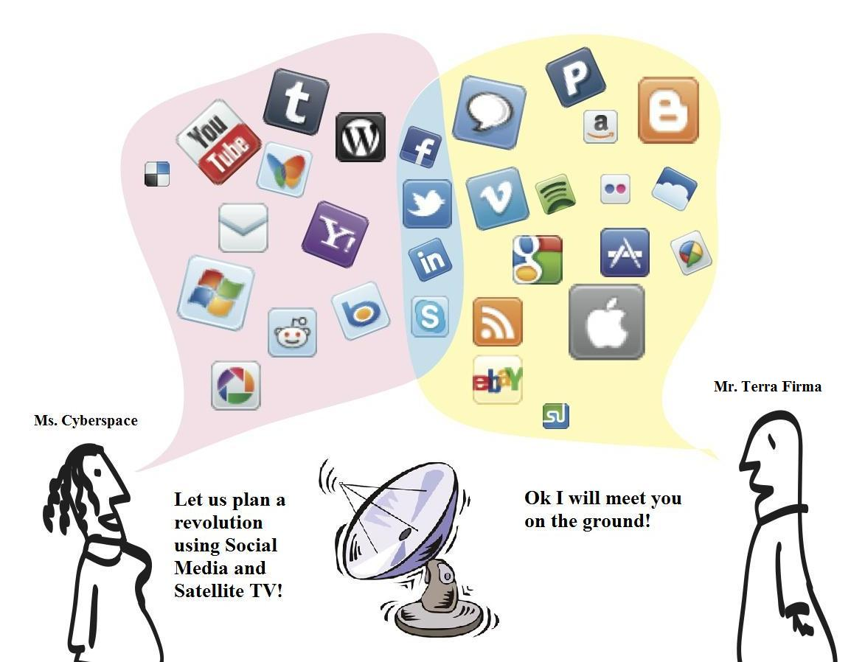
From Cyberspace to Physical Space
Aluta Continua!

Slide 8
Unified field of Political Activism!
Cyberspace Vs. Terra Firma
or
Cyberspace + Terra Firma
To compensate for gaps in the digital divide
i.e. access to internet and to social media channels

Slide 9
Satellite TV | Integrate | Social Media
Al Jazeera Al Arabiya Etc. | How? TV Satellite Channels: Using video clips, photos from cameras & mobile phones uploaded to: YouTube Facebook Blogs Tweets from twitter Articles from blogs Etc. TV Channels inside Social Media Platforms: Interactive websites. Facebook Pages, Twitter accounts, Blogs, etc. Live Broadcast inside social media sites. | Facebook Twitter (microbloging) YouTube Flicker Skype Blogs
Revolutionary Civil Activism

Slide 10
From Cyberspace to Terra Firma:
Influencing the
Political Organization of Space
On the Local level
On the National level
On the Regional level
On the International level
HOW?

Slide 11
TV, Social Media & Territoriality
Robert Sack (1986) defines territoriality as "the attempt by an individual or group to affect, influence, or control people, phenomena, and relationships, by delimiting and asserting control over a geographic area“.
Sack (1986) sees territoriality as an “indispensable means to power at all levels: from the personal to the international”.

Slide 12
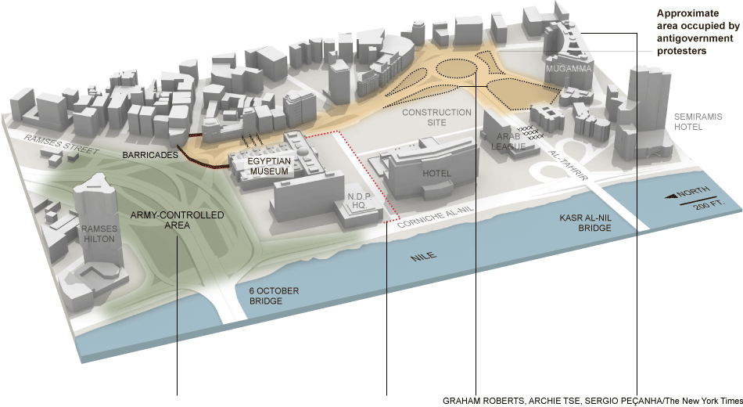
Tahrir Square in Cairo

Slide 13
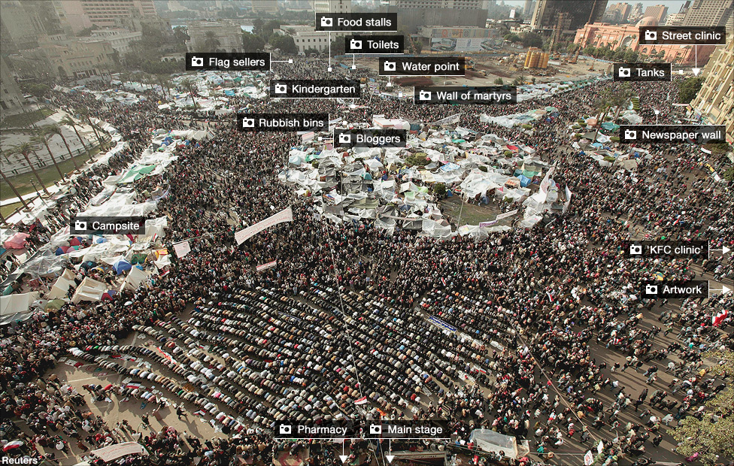
“The Camp that toppled a president” (BBC, Feb 11, 2011)

Slide 14
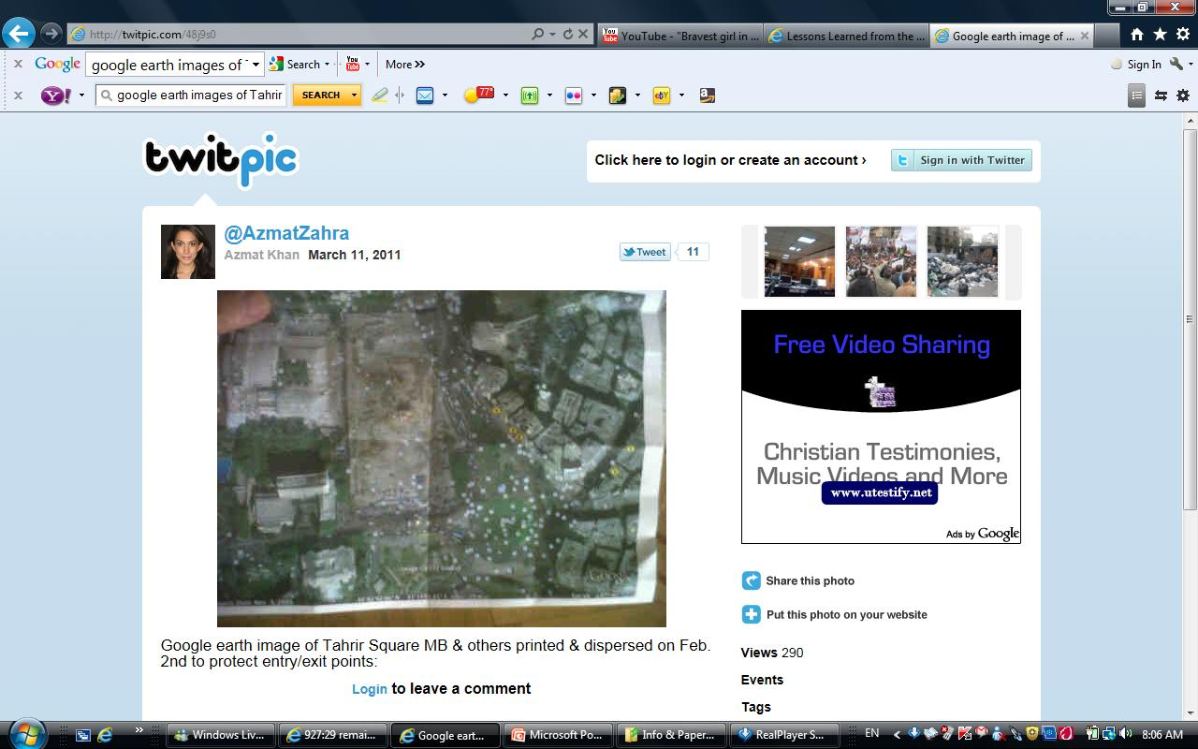

Slide 15
The (Broadcaster Activist) vs. (The Activist Broadcaster)
A journalist/broadcaster who is supporting social change agendas & who is communicating with audience through classical and social media platforms | An activist who is using social media & blended media platforms to further his/her political, economic, social, cultural agenda(s)

Slide 16
(Integrating Social Media and TV) Social, Political, Economic and Cultural Agendas
Against | For
Injustice Oppression: Dictatorship Totalitarianism Colonialism Imperialism War Racism Colorism Sexism Xenophobia Classism Religious Bigotry Marginalization Inequality Corruption Etc. | Justice Freedom Equality Peace Democracy Human Rights Civil Rights Political Rights Economic Rights Cultural Rights Women rights Children Rights Labor Rights National Rights Religious Rights Good Governance Etc.

Slide 17
Revolution and the
(W5+H) of Integrating TV & Social Media
What | Where | When | Who | Why | How
Integrating TV & Social Media for Revolutionary Civic Activism | Spatial Dimension: Local National Regional International Networking to increase geographic extent/span Transcend geographic levels (from local to global and from global to local). Examples: Arab World | Temporal Dimension: Immediate Short term Medium term Long term (Strategic) Future! Spring 2011 March 15 May 15 Beyond into the future… | Individual, Group: Historical personality political personality Cultural personality Family Tribe Political party Organization Association Gang People Nation Young People Civil society Etc. | To change an oppressive social order & To achieve justice, freedom, equality and peace. To transcend or overcome Restrictions or Preventions on: Movement Access Land ownership and use. Censorship | Blending and integrating social media and TV to: Propagate and Expand social ideas and agendas. Inform Explain Recruit Lobby Influence Alter Change Win

Slide 18
Examples of using TV & Social media for revolutionary activism
Tunisia (Sidi Bouzaid)
Egypt (April 6 Movement; We are all Khaled Said FB Group; Jan 25, 2011)
Yemen
Bahrain
Libya
Syria
Palestine:
  March 15 (Movement for National Unity)
  May 15 (Right of Return March/Third Intifada)

Slide 19
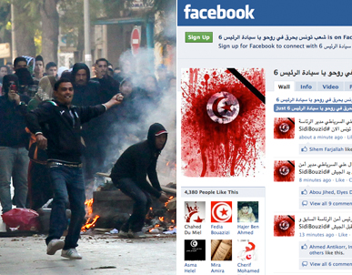

Slide 20
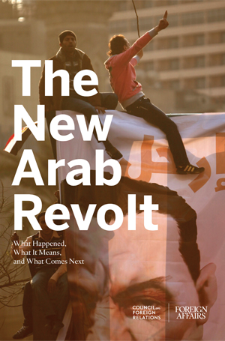
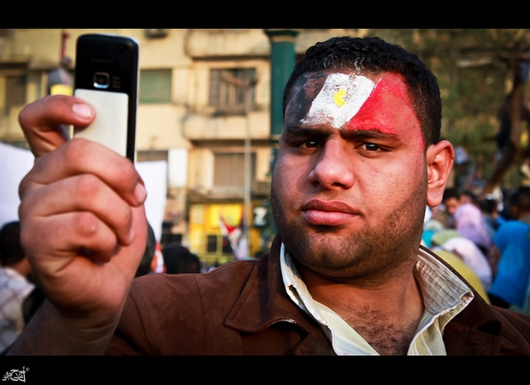
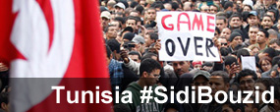

Slide 21
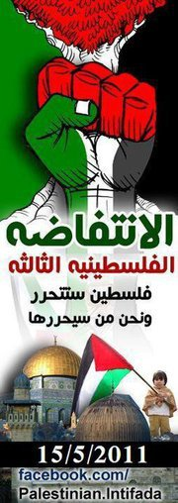
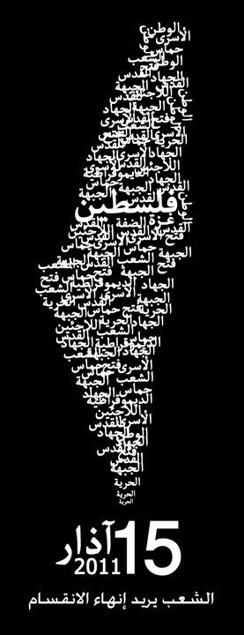
May 15
(Right of Return March/Third Intifada
  March 15
  (Movement for National Unity)

Slide 22
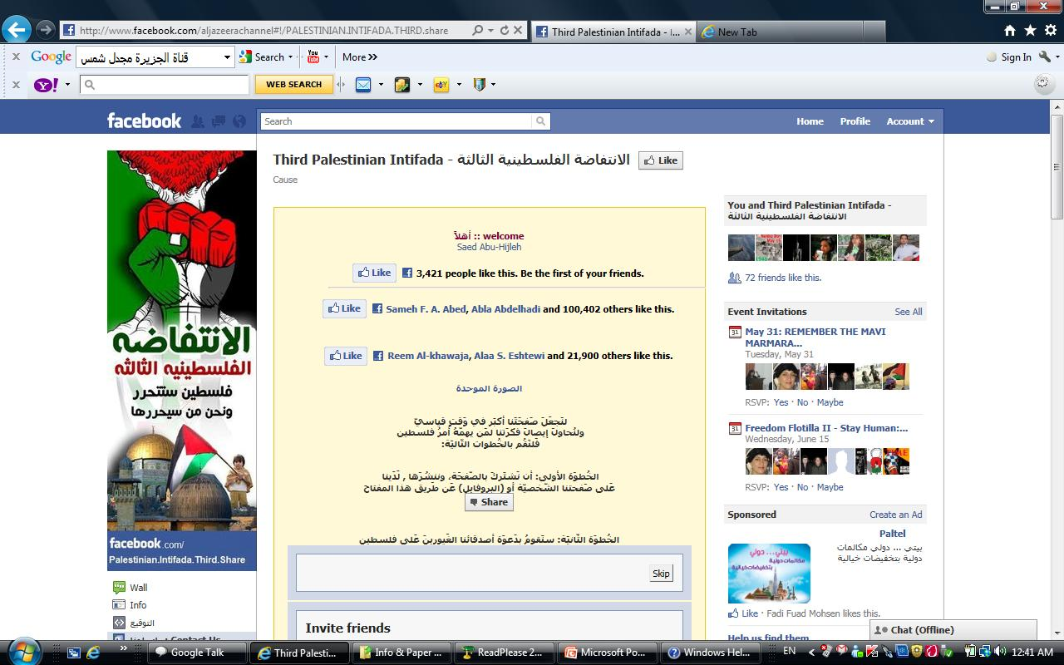

Slide 23
  May 15, 2011 “Right of Return March” &
  “Third Palestinian Intifada” an event organized over social media (Facebook & Twitter) and covered and highlighted by Arab Satellite Channels
  Ilustrating the Power of Ideas!!
  Unarmed civilian refugees cross a mine field to go to back to their homeland and get massacred!!!
  ..\..\..\Videos\RealPlayer Downloads\Video of Palestinians into Majdal Shams into Palestine2.flv
  ..\..\..\Videos\RealPlayer Downloads\Video of Palestinians into Majdal Shams into Palestine3.flv

Slide 24
Big warning for revolutionary social movements!
“Qanwanit al nidal” ”قنونة النضال“ which means the channeling of struggle or activism:
  Social movements get dependent on channels/networks/platforms/tools that they do not control/own.
  ** Danger of destroying/sabotaging social movements or agendas by shutting/closing/removing channels/networks/platforms.
  Solutions/Alternatives
  (Examples: Palestinian, Egyptian)

Slide 25
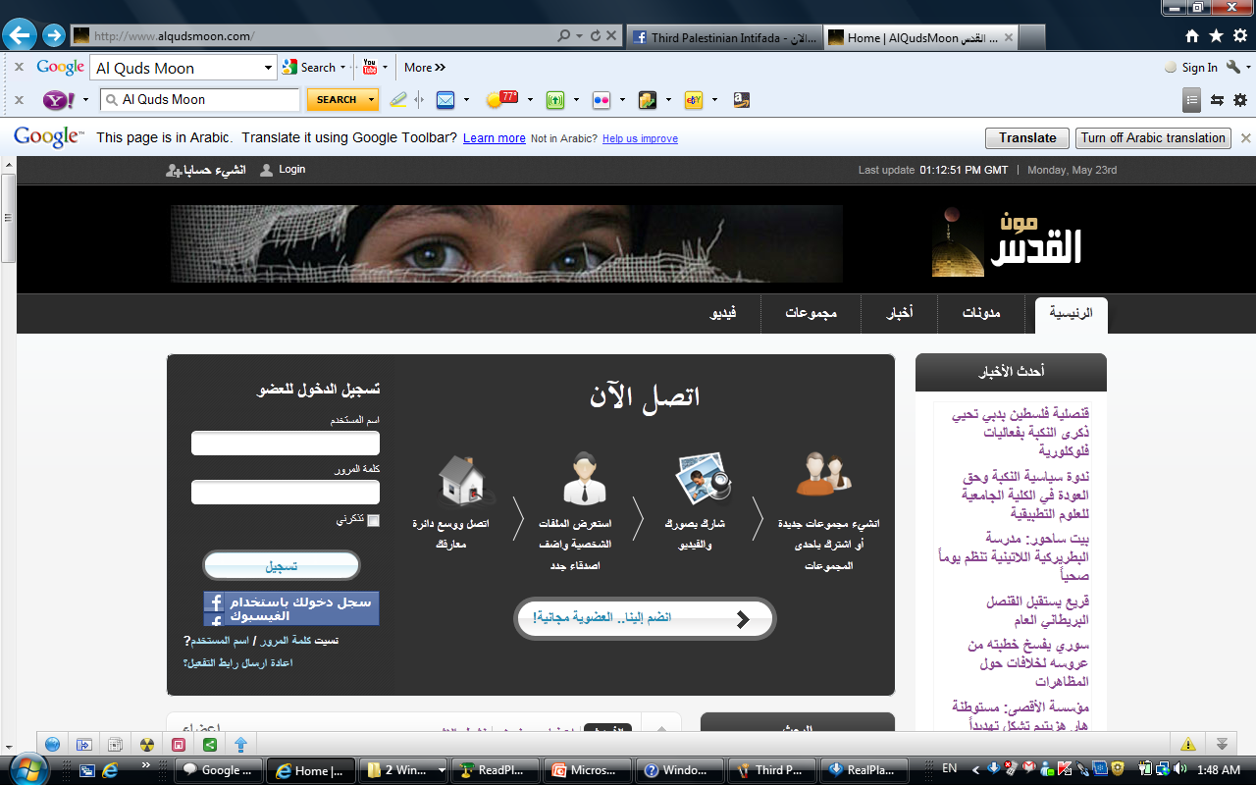

Slide 26
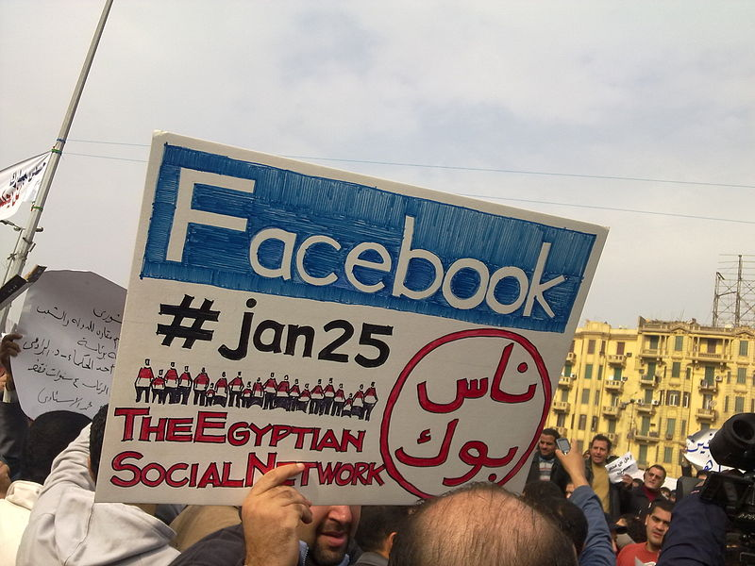
Facebook vs. (ناس بوك)(Peoples Book)

Slide 27
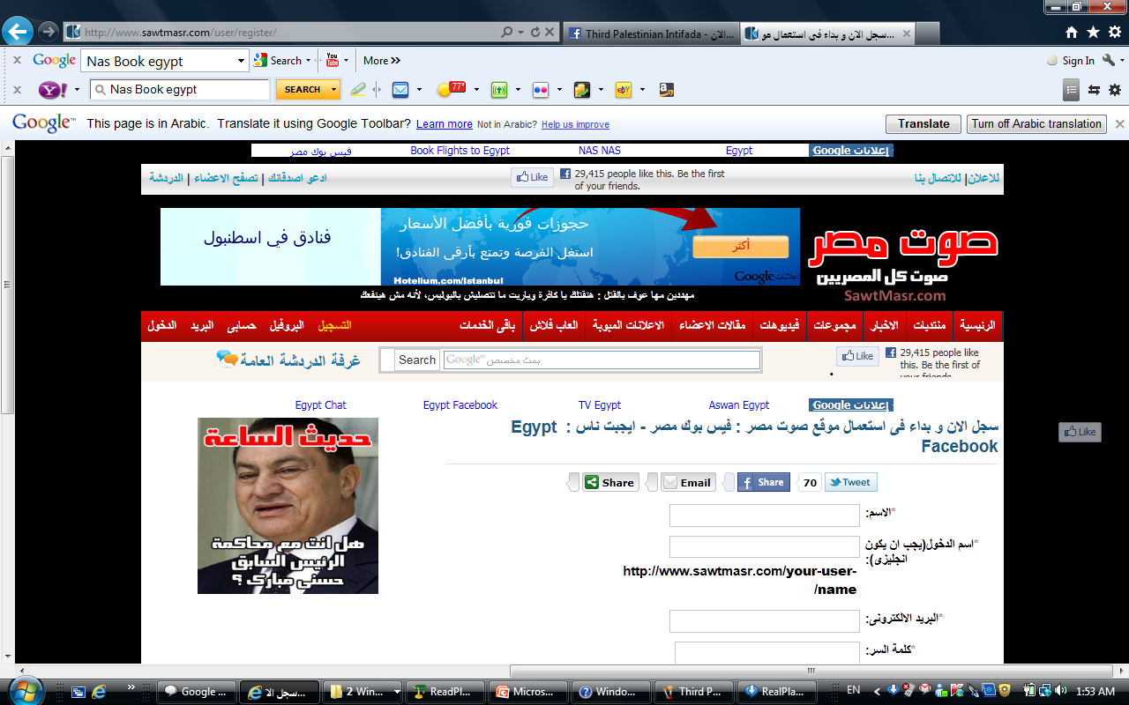

Slide 28
Integrating TV and Social Media
(Positive vs. Negative)
Propaganda to propagate oppressive sociopolitical and socioeconomic regimes and orders.
Propaganda to destabilize/overthrow of progressive or democratically elected regimes.
Terrorism (Individual, group, state-sponsored).

Slide 29
The Future is already here!
Broadcasting as we know it has already changed, is changing now, and will continue to change in the future; the question is how and in which direction. The best we can do is doing informed predictions and the gagging of trends.
(Al Jazeera’s “The Stream” & “Storify”!)

Slide 30
Thank You & Salaam Alikom
السلام عليكم
Saed J. Abu-Hijleh
Center for Global Consciousness (CGC)
Nablus, Palestine
E-mail: sindbad1982@gmail.com
Blog: abuhijleh1982.blogspot.com
Website for my mother:
www.remembershaden.org

